Slide 1
Software Systems Design and Integration
Lecture 10, Part II
Developing Session Beans

Slide 2
Aims
Understand the difference between stateful and stateless session beans
Understand the difference between local and remote bean interfaces
Go step-by-step through the process of creating the EJBs
Learn how to deploy the session beans
Learn how to create session bean clients

Slide 3
Content
Types of session beans
Lifecycle Methods
Developing session beans
Packaging and deployment of session beans
Creating session bean clients

Slide 4
1 Types of session beans
Two types of session beans run within the EJB container, differing in the business functionality
  Stateless: Simple remote method calls without client-specific or session-specific information
  Statefull: Information passed during one method call is used during subsequent method calls (session maintenance)
  Singleton: Bean have only one instance (for implementing singleton design pattern)
Examples of context information which requires session: enforcing master-detail dependencies (holding master primary key while manipulating detail record), state maintenance (holding shopping cart alive), data and operation synchronization (balancing accounts during transactions), etc.

Slide 5
Maintaining state
The session data can be stored in different tiers
 | Client-side | Server-side Web tier | Server-side Business tier | Data tier
Where | Any objects (desktop app), cookies (Web app) | Servlet session objects | EJB session beans | Status attributes of records, Log files
Pros | + Tracking clients + Multiple connections + The fastest | + Using pool of shared beans + Faster | +Using pool of shared connections + More secure | +Gathering statistical information + Clustering and failover
Cons | - Less secure | - Extra session tracking | Less fast Extra session tracking | Very slow

Slide 6
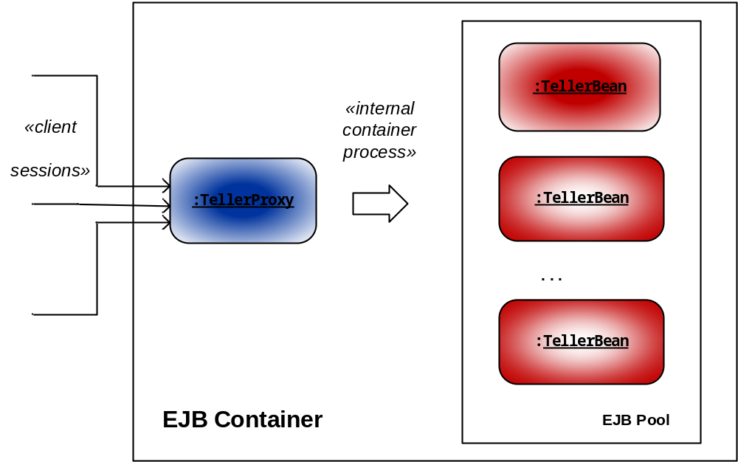
2 Lifecycle of the session beans
2.1 Stateless Beans

Slide 7
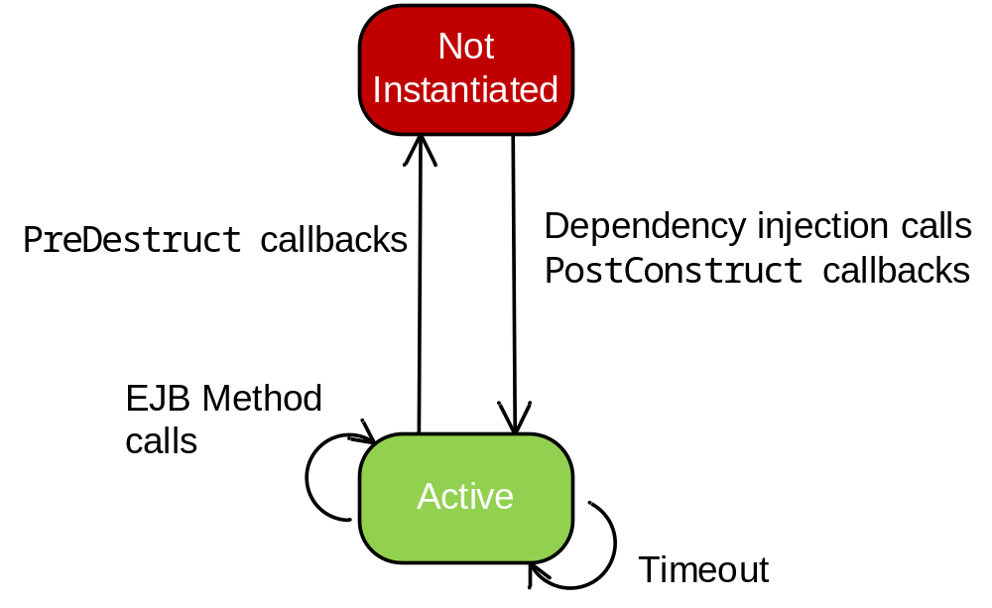
Stateless EJB Lifecycle

Slide 8
Lifecycle Event Handlers of Stateless Beans
PostConstruct – methods which are executed by the container automatically after instantiating the bean (before initalization of the bean for perfoming business operations)
PreDestroy – methods which are executed by the container automatically before destroying the bean (after finishing the business operations)
Also known as callback methods. All callback methods must be void and with no parameters so that the container can invoke them automatically

Slide 9
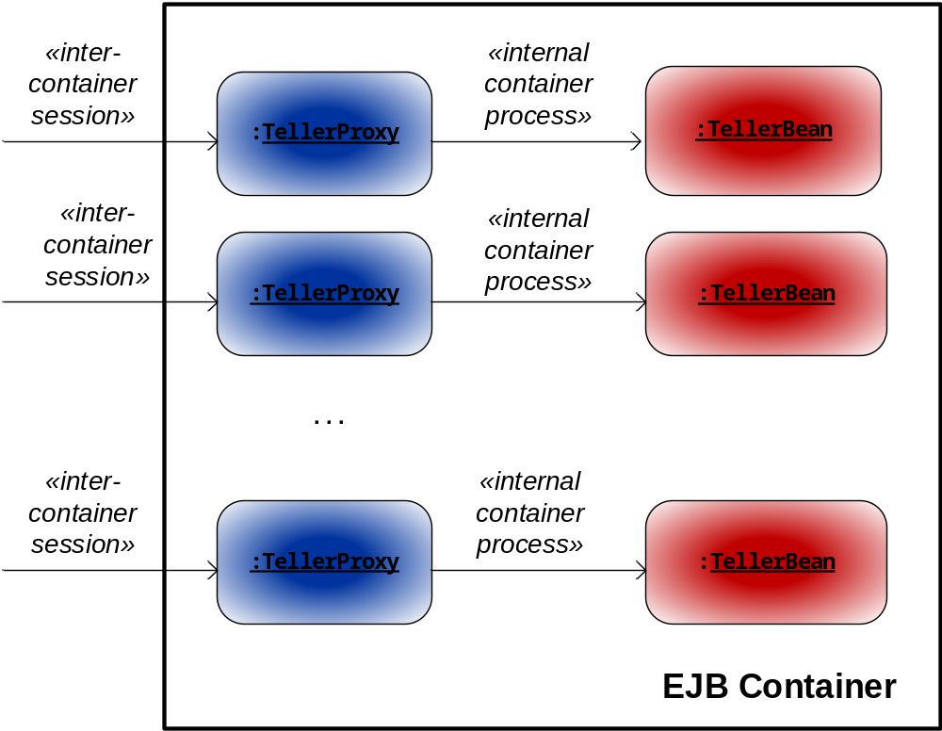
2.2 Stateful Beans

Slide 10
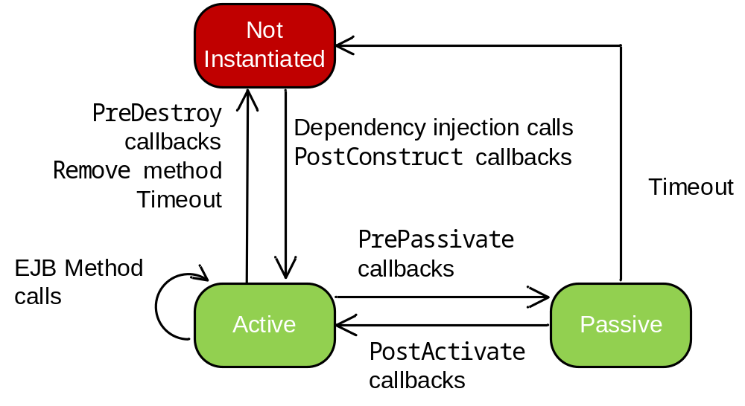
Stateful EJB Lifecycle

Slide 11
Lifecycle Event Handlers of Stateful Beans
PostConstruct – executed by the container immediately after instantiating the bean (before initialization)
PreDestroy – executed by the container before destroying the bean (for releasing the resources hold by the bean permanently – i.e., database connections)
PostActivate – executed by the container after re-activating the bean (for re-establishing the resources specific to the business operations)
PrePassivate – executed by the container before temporary deactivating the bean (for releasing the resources hold by the bean temporarily – i.e., sessions)
All callback methods must be void and with no parameters so that the container can execute them

Slide 12
2.3 Singleton Beans
Maintains state across calls (stateful)
Only one bean per container created (cashing the last call – suitable for implementing logs, pools, etc.)
Sharing the same bean among several sessions (suitable for implementing 1:M design patterns such as facades, dispatchers, brokers, schedulers, observers, data access objects, etc.)
Concurrent access to the bean from multiple source synchronized by the container automatically
  @Singleton
  public class CashBean {...}

Slide 13
3 Developing session beans
Steps:
Specifying the interface of the bean (if remote - required, if local only - not required); one bean can have combination of remote and local interfaces
Creating the class which implements the bean
Annotating the bean so that the container can register it with JNDI registry (as part of the implementation class – if used locally)
Providing bean deployment descriptor (as part of the application – if used remotely)

Slide 14
3.1 Remote Interface
Standard Java interface
Specifies the business methods which the bean should implement for remote access (optional)
Specifies the session type which the bean should maintain (local or remote, optional)
  import javax.ejb.*;
  @Remote
  public interface Teller {
  float getBalance();
  }

Slide 15
Remote EJB interfaces are not java.rmi.Remote interfaces like the interfaces which specify the remote methods of the RMI server (they are invoked by the container within the same JVM, not remotely by the client)
The methods of the remote EJB interfaces do not throw java.rmi.RemoteException (the control remains within the same JVM)
They should expose only methods with valid RMI/IIOP data types as parameters and results (i.e., serializable)
They should not expose local data types, timers or time handlers which are relative to location of the implementation

Slide 16
3.2 Local Interfaces
Expose methods for local access to the bean from a process which runs within the same JVM
If there is no interface, by default the bean exposes only its public methods for local access from the same container
Interface | Implementation
@Local public interface Teller{ ... } | @Stateless public class TellerBean implements Teller{...}
public interface Teller{ ... } | @Local @Stateless public class TellerBean implements Teller{...}
public interface Teller{ ... } | @Stateless public class TellerBean implements Teller{...}

Slide 17
3.3 Bean Implementation
The implementation class should be public (to be visible), not abstract (to be able to subclass), and not final (so that its slots can be changed)
It must have a constructor without parameters to be used by the container to create bean instances
It should not have finalize methods in the code
  @Stateless
  public class BasicSessionEJB implements
  BasicSessionEJBRemote {
  public BasicSessionEJB() { ... }
  public String getMessage() {
  return "Hello, EJB Wolrd!";
  }
  }

Slide 18
Can implement more than one business interface - both local and remote
Must implement all interface methods - specified by local, remote and additional interfaces
Can implement also some lifecycle methods (optional)

Slide 19
Example: Shopping cart with lifecycle methods
import javax.ejb.*;
import java.util.*;
@Stateful public class ShoppingCart
implements ShoppingCartRemote{
private float totalCost;
private int totalCount;
private String[] products;
private int[] quantities;
public void addProduct(String prod,int qty)
{...};
@PreDestroy private void clearCart()
{...};
}

Slide 20
3.4 Obtaining the session information from the container by a Session Bean
The class javax.ejb.SessionContext is automatically instantiated by the container when a new EJB session is started
It holds information related to the session ID, security discipline and transaction status of the current session and is available during the entire lifecycle of the bean
We can make use of this information within the bean through annotation @Resource referring to the instance of the class

Slide 21
Example: BankingBean with Session Control during Transactions
import javax.ejb.*;
import javax.annotation.*;
@Statefull public class TellerBean
implements Teller {
@Resource private
javax.ejb.SessionContext BankingCtxt;
public Boolean commitTransaction(){
Boolean transStatus = BankingCtxt.getStatus();
...
}
...
}

Slide 22
4 Deployment of Session Beans
The deployment process includes three tasks:
  Creating a deployment descriptor (an XML file) – optional; an archive can be generated instead
  Creating a deployable component archive (a .jar file)
  Deploying the EJB component – either using deployment descriptor and manually copying the files to the location of the bean, or copying the deployable archive to the server autodeployment folder
For Glassfish the autodeployment folder is at
  <glassfish_home>\domains\domainX\autodeploy\

Slide 23
Example: Deployment Description for Session EJBs in the EJB container
<ejb-jar>
<display-name>BankSystem</display-name>
<enterprise-beans>
<session>
<ejb-name>TellerBean</ejb-name>
<business-remote>Teller</business-remote>
<ejb-class>bank.TellerBean</ejb-class>
<session-type>Stateful</session-type>
</session>
</enterprise-beans>
</ejb-jar>

Slide 24
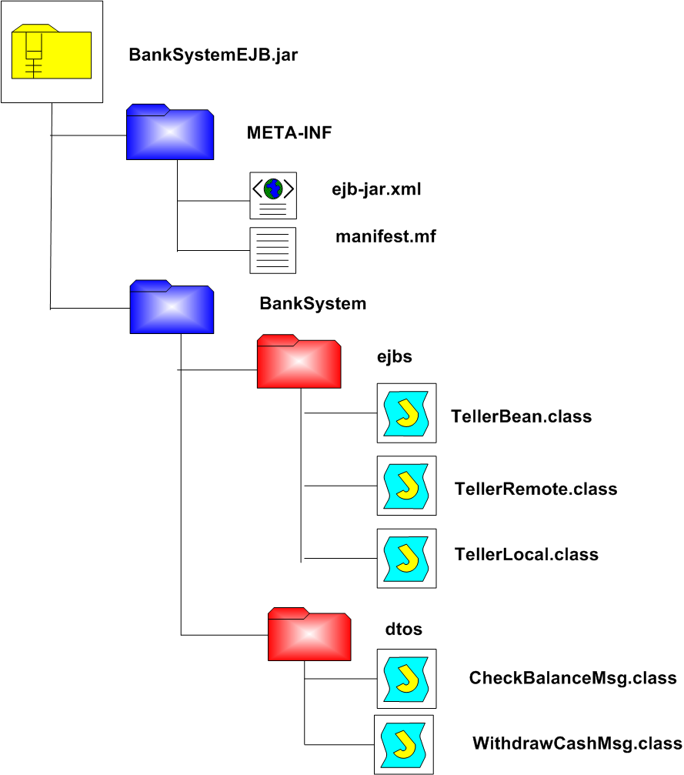
Structure of EJB Component Archive

Slide 25
Deployment Assembly
If the EJBs form part of a Java EE application which includes other components (i.e., servlets), the .jar archive which contains the EJBs together with the .war archive which contains the Web components can be assembled in a deployment assembly to form parts of one single .ear archive
In Eclipse this can be automated through specifying Deployment Assembly property – the project which is an assembly, normally Dynamic Web project, incorporates the beans, developed as a separate Enterprise Bean project
The assembly will have specifications for the beans in the descriptors of both containers

Slide 26
Example: Deployment description for session EJBs in the Web container
<ejb-ref>
<ejb-ref-name>Teller</ejb-ref-name>
<ejb-ref-type>Session</ejb-ref-type>
<remote>TellerRemote</remote>
</ejb-ref>
The beans in the assembly are referred to directly within the Web container as remote
In previous versions of Java EE the calls to the beans were executed as remote, but in Java EE 6 and later the container will execute them as local

Slide 27
5 Creating Session Bean Clients
The EJB clients do not communicate directly with the beans; they communicate with the bean proxies
The EJB proxies can be found in the JNDI registry where the bean is registered
  the local clients can use the proxies to work with the beans as they are
  the remote clients may need to perform downloading of the proxies and creating of stubs (client-side proxy) in order to be able to communicate with the skeletons (server-side proxy) of the beans

Slide 28
5.1 Methods for registration and lookup for the beans
In order the client to be able to communicate with the EJB the programmers need
  to choose an appropriate method for registering the bean in the JNDI registry on the server
  to locate the JNDI registry in which the bean is registered on the client
  (optional) to perform lookup for the bean in the remote registry
The JNDI registration can be done either implicitly by the container, or explicitly using annotation or deployment descriptor

Slide 29
Registration
The beans can be used with their original names within the same container without lookup, or with nicknames, which gives the possibility to be used outside the container and requires additional lookup
@EJB(mappedName=“ejb/TellerBean”)
The lookup for the bean inside the JNDI registry must match the registration of the bean

Slide 30
Lookup
The lookup for the bean can be performed after initialization of the context for searching in a node of the lookup tree of the JNDI registry
Properties init = new Properties();
init.put(Context.PROVIDER_URL,
"iiop://srv.ibank.com:7676");
Context ctxt= new InitialContext(init);
If the property parameters used to initialize the context do not contain PROVIDER_URL attribute, the JNDI registry is assumed to be on the same server

Slide 31
5.2 Creating local EJB Clients using the Java EE container services
We don’t need to program the bean lookup – the EJB container will locate the bean within the container automatically (for standalone server-side apps and server-side components only)
Calling to the bean methods as native Java calls is possible for all public methods of the bean
Calling to the bean methods exposed via remote interfaces is automatically converted into local calls

Slide 32
Example: Local Native Calls to the EJB methods of the bean
import javax.ejb.*;
public class LocalBankClient {
// locating the bean within the container
@EJB private static TellerBean acc;
public static void main (String args[]) {
private float balance;
// invoking the bean method locally (native)
balance = acc.getBalance();
...
}
}

Slide 33
5.3 Creating EJB clients which use local nicknames
This method of registration requires declaring of a nickname for the bean; it can be done using proper annotation, i.e.
@EJB(mappedName=“ejb/TellerBean”)
Works with both Web container and EJB container of Java EE compliant server
Local access to the bean methods within the same container does not require additional lookup, while local access on the same server does

Slide 34
Example: Explicit lookup for EJBs registered with nicknames
If the client is on the same host as the bean (i.e., for desktop applications, or other enterprise applications), the lookup can be done within the default JNDI context of the server
try {
Context ctx = new InitialContext();
TellerRemote bean =
(TellerRemote) ctx.lookup("ejb/Teller");
balance=bean.getBalance();
...
} catch (NamingException e) {
e.printStackTrace();
}

Slide 35
Example: Implicit lookup for EJBs located on the same host
When the client is within the same application as the bean (for example, the EJB service client is a servlet), there is no need to perform explicit lookup - the server will do this automatically
@EJB (lookup="ejb/TellerBean")
private TellerRemote bean;
In such a case the container will perform an additional optimization, transforming the remote calls into local calls

Slide 36
5.4 Creating portable EJB clients which use global JNDI names
Uses standard JNDI naming convention
  java:global/[<app-name>]/<mod-name>/<bean-
  name>!<bean-interface> - for more than one interfaces
java:global/[<app-name>]/<mod-name>/<bean-name>
The various names refer to the archives as follows
      <app-name> is the name of the application archive (the .ear file name without extension). This can be overridden in deployment descriptor application.xml.
      <mod-name> defaults to a module archive name (.war or .jar without the bundle extension). Again, this can be overridden in deployment descriptor ejb-jar.xml.
      <bean-name> defaults to the unqualified bean class name (without package extension). Can be overridden with annotations which have mapped-name attribute

Slide 37
Example: Finding EJBs injected using global JNDI names for remote calls
EJB ShoppingCart from an application TradeApp, packed in an archive file TradeApp.jar:
  package com.trade.shop;
  @Stateful
  public class ShoppingCart
  ...
  }
Global JNDI names available for remote lookup for ShoppingCart from the client side
java:global/TradeApp/ShoppingCart
java:global/TradeApp/ShoppingCart!com.trade.
shop.ShoppingCartRemote

Slide 38
5.5 Creating remote EJB Clients using the Java SE services
In the case of remote Java SE clients (desktop applications) and remote Java EE clients (remote server-side components) we need to perform explicit lookup after initialization of the search context
If the bean has a remote interface, the client will use the name of the interface for finding the bean proxy object inside the JNDI registry
If the bean does not have a remote interface, the client will use the name of the bean class instead

Slide 39
Example: Remote EJB Calls using the Java SE services
import javax.naming.*;
import javax.rmi.*;
public class RemoteBankClient {
public static void main (String args[]){
Properties props = new Properties();
props.put(Context.PROVIDER_URL,
"iiop://srv.ibank.com:7676");
Context ctxt= new InitialContext(props);
Object proxy=ctxt.lookup(“ejb/Teller”);
Teller acc=(Teller) PortableRemoteObject.
narrow(proxy,Teller.class)
System.out.println(“Balance=“+acc.getBalance());
}
}

Slide 40
Locating the Beans (Summary)
The same container
The same host
Remote host
The same application
No need for @Local refs – native calls
No need for JNDI lookup – the same namespace
No need for dependency injection or deployment descriptor
Both @Local and @Remote as local
No need for explicit JNDI lookup – done by the container
Dependency injection suffices
Both @Local and @Remote references
Default or global JNDI naming
Dependency injection (default) or deployment descriptor
@Remote references only
Global JNDI naming and portable proxies
Deployment descriptor (default) or dependency injection

